Slide 1


CARBON CYCLE SOLUTION
LoopZone Industries
Presented By:
Afsana Turabin Indana: 22201235
Shadman Sarwer : 22201242
H.M. Tahsin Sheikh : 22201243
Humayra Jihan Arpita: 22201244
Presented To:
Nadeem Ahmed
Assistant Professor
University of Asia Pacific

Slide 2
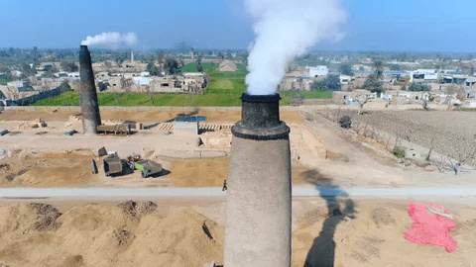
Overview
Integration Management
Scope Management
Managerial Capabilities and
Leadership Skills
Risk Management

Slide 3


Introduction
Carbon Utilization in Brick Fields
Objective:
Use captured carbon emissions from brick fields to create and sell eco-friendly products like pencils, cement, and even carbon credits.
Big Idea:
Transform pollution into products and profits while promoting sustainability.

Slide 4
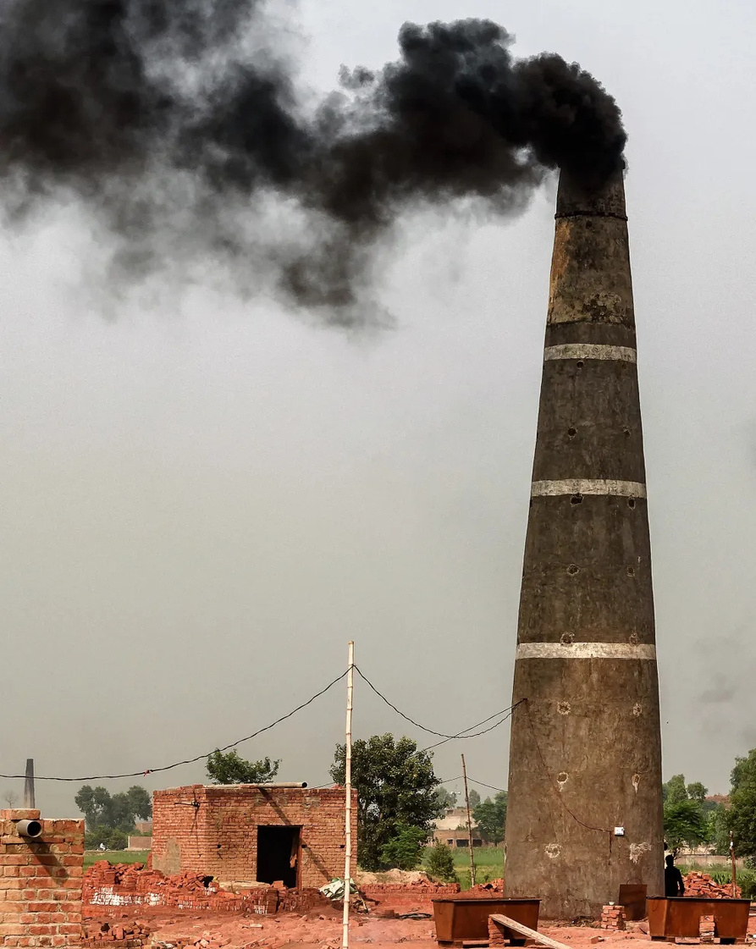



Integration Management
Execution:
Install capture tech at pilot sites.
Start pencil and eco-cement production.
Develop marketplace for green products.
Integrated Change Control:
Change Control Board (CCB) setup.
Allow for iterative product improvements.
Adapt to new government carbon regulations.
Software to Use:
Trello: Workflow and task management
Jira: Bug tracking and change requests
Excel: Carbon credit accounting
Zoom/Skype: Team meetings

Slide 5

Integration Management(Cont...)
Project Plan Development
Introduction: Brick Field Carbon Capture & Reuse Project
Organization: Led by EcoTech Solutions
Managerial Process: Agile Methodology + Regular review meetings
Technical Process: Install carbon capture units; process carbon for secondary products
Work Packages:
Carbon capture setup
Product manufacturing (pencil, cement)
Sales & marketing
Schedules/Budget: 18 months project cycle / $500K

Slide 6
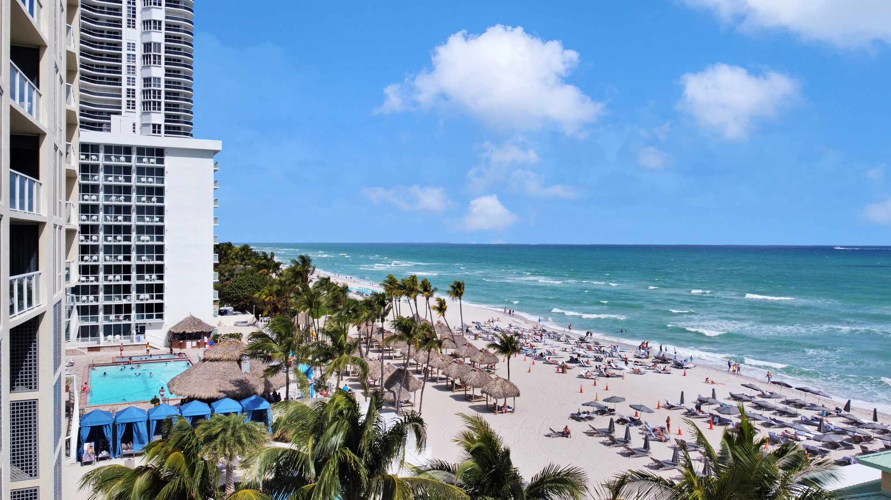
Scope Management
Plan Scope Management
Define how the project's scope will be defined, verified, and controlled.
For Brick Field Carbon Project:
Scope Management Plan to guide how carbon capture, product development (pencil, cement), and carbon sales will be handled.
Use clear acceptance criteria: e.g., minimum 20% carbon emission reduction.
Collect Requirements
Gather needs from all stakeholders.
Methods: Interviews with brick owners, surveys for green product consumers, government compliance requirements.
Key Requirements:
Safe carbon capture tech.
Eco-friendly pencil and cement quality.
Carbon credit registration.

Slide 7
Scope Management(Cont..)
Define Scope
Create a clear project scope statement.
In Scope: Carbon capture installation
Out of Scope: Brick field modernization
Create WBS (Work Breakdown Structure)
Break project into small, manageable tasks:
Carbon capture unit installation
Graphite extraction for pencils
CO₂-curing of cement
WBS allows better assignment of tasks and progress tracking.

Slide 8
Scope Management(Cont..)
Validate Scope
Formal acceptance of completed deliverables.
How: Regular Stakeholder approvals after milestones.
Example: Eco-pencils and getting customer feedback.
Control Scope
Monitor project scope and manage changes carefully.
Tools: Approval by Change Control Board (CCB).
Prevent scope creep by sticking to carbon capture

Slide 9
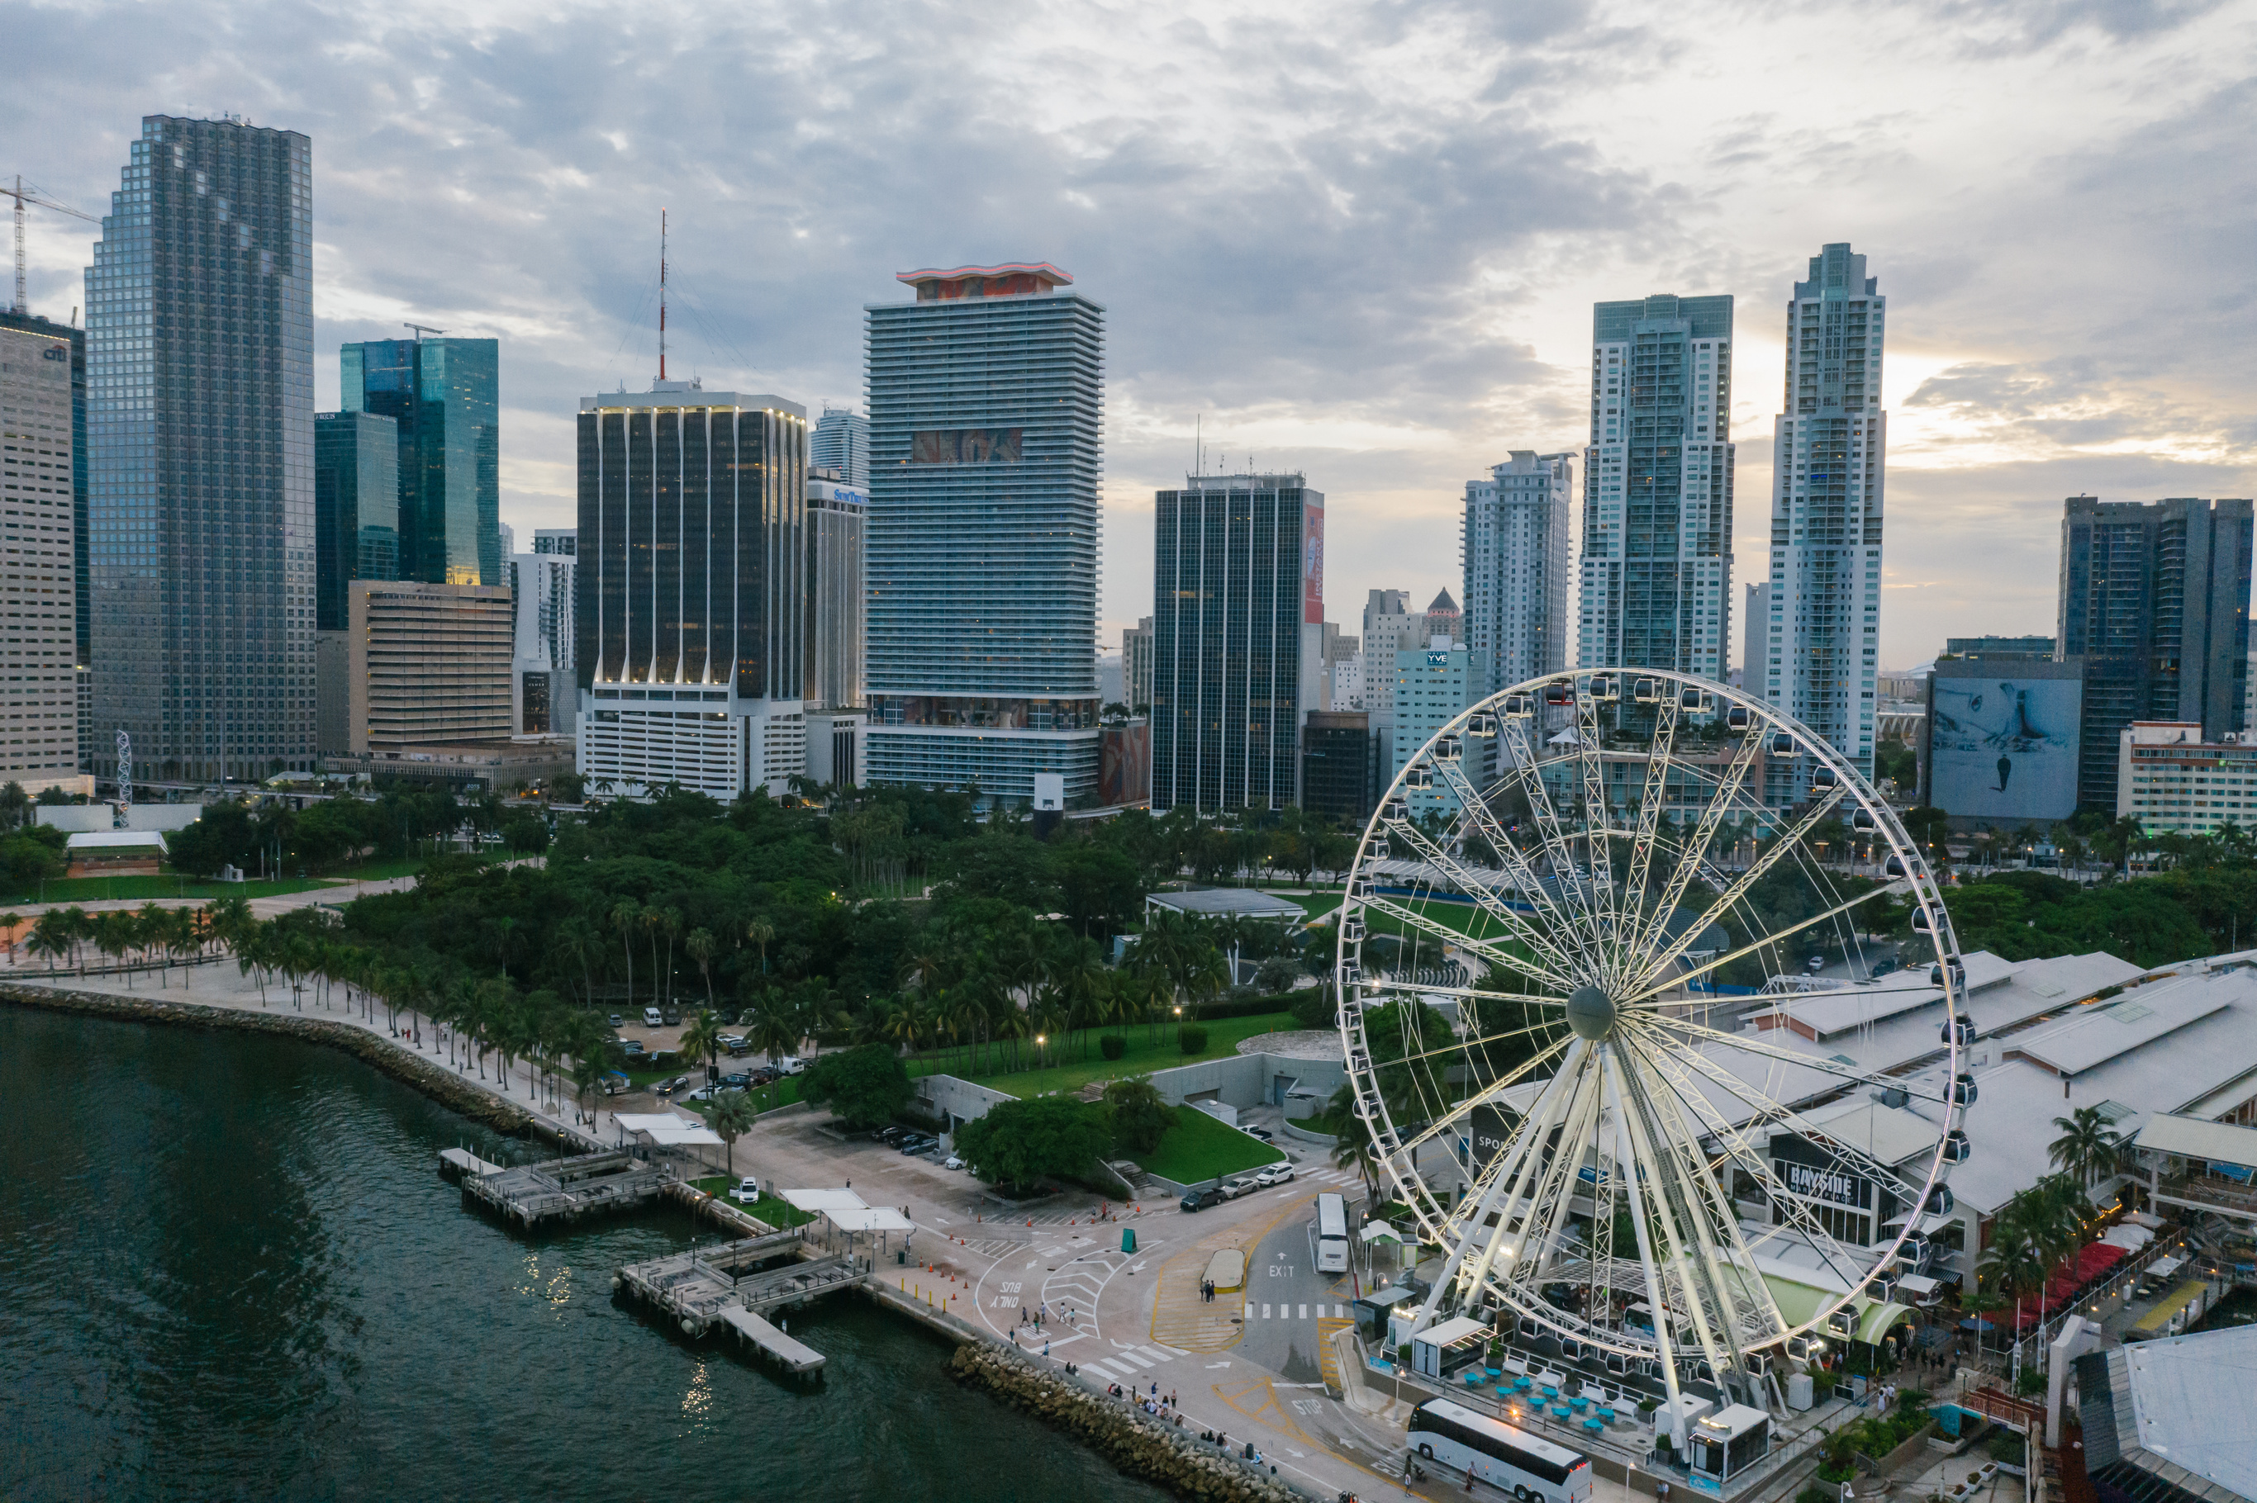



Role of the project manager
Task Organization:
Plan carbon capture, pencil production, and eco-cement creation.
Resource Planning:
Allocate funds, schedule manpower for carbon unit installations, product manufacturing.
Progress Monitoring:
Track emissions reduction, product quality milestones, and carbon credit sales achievements.

Slide 10





Role of the project manager(Cont...)
The Project Manager Must Fulfill Four Roles:
Communicator
Role
Controller
Leader
Planner
Actions in the Brick Field Project
Allocate funds, schedule manpower for carbon unit installations, product manufacturing.
Track emissions reduction, product quality milestones, and carbon credit sales achievements.

Slide 11

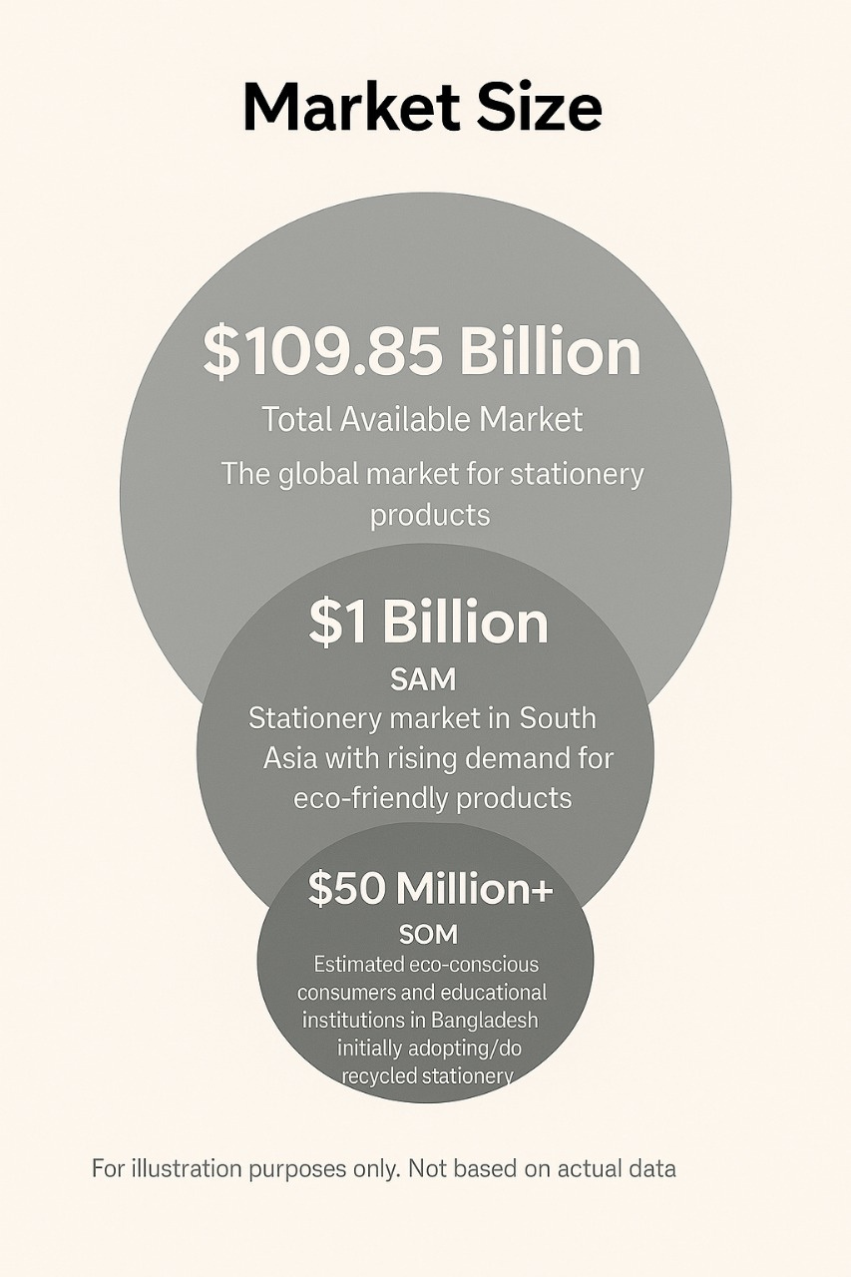

Project Risk Management
Planning Risk Management
Develop a Risk Management Plan early during project planning, to define how risks will be identified, analyzed, responded to, and monitored.
2. Identifying Risks List potential risks that could affect the project’s success (see below).
3. Performing Qualitative Risk Analysis
Prioritize risks based on their probability of happening and their potential impact.
4. Controlling Risks
Track identified risks, monitor residual risks, identify new risks, and execute risk response plans.

Slide 12





Thank You
Gerente General

Slide 13

ANY QUESTION?

